Slide 1
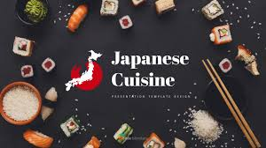

Slide 2
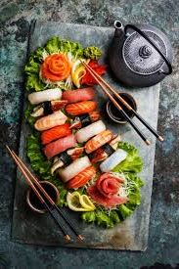
Japanese Cuisine
The food – ingredients, preparation and way of eating of JAPAN.
Based on rice with miso soup and other dishes, emphasize the seasonal ingredients.
SIDE DISHES – often consist of fish, pickled vegetables, and broth cooked vegetables.

Slide 3
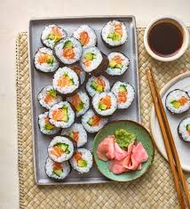
Fish is common. It is often grilled, but it may also be served raw as sashimi or in sushi.
Seafood and vegetables are also deep-fried in a light batter as tempura.

Slide 4
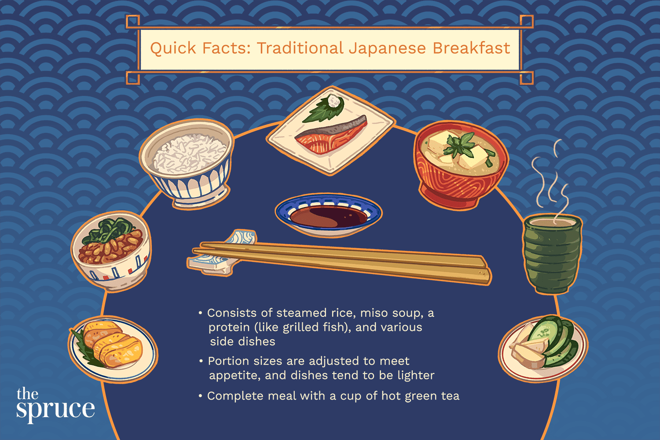

Slide 5
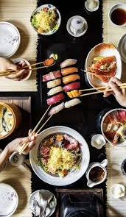
Seafood is highly consumed since the country is surrounded by oceans.
Seaweed, fish, clams, fish cakes are popular ingredients in Japanese cooking.

Slide 6
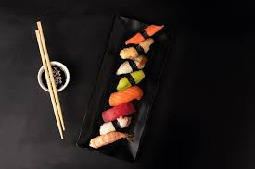
The History

Slide 7
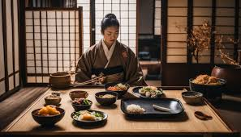
Influenced by Korea and China.
Korea introduce rice and became staple.
China introduce soy bean and wheat after rice.
They also introduce the use of chopsticks and drinking tea to Japanese
When Buddhism became the official religion pf Japan, the consumption of meat was prohibited.

Slide 8
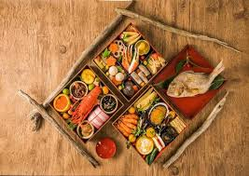
Feature of Japanese Cuisine

Slide 9
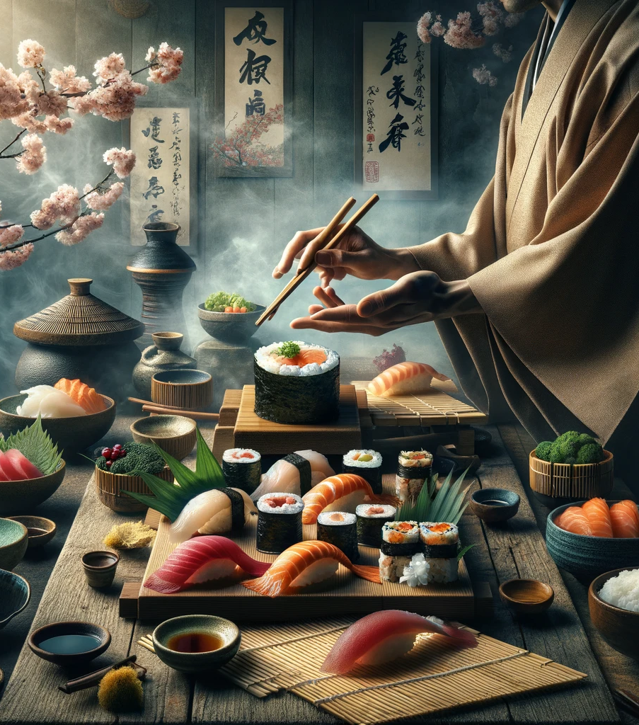
Secret of Japan
Thorough selection of products, beauty of serving and respect of products in general.
Main Rule: Don’t create but find and discover.

Slide 10
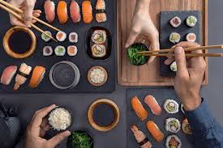
EATING
HABITS

Slide 11
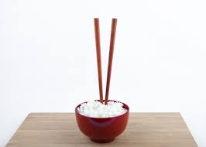
Never use your hand to catch falling food.
Avoid using your teeth to bite food in half.
Never mix wasabi into your bowl.
Don’t place clam shells in the bowl’s lid or on a separate plate.
Don’t hold chopsticks before picking up your bowl.
Don’t hover or touch food without taking it, and always pause to eat your rice.
Never rest your chopsticks across the top of your bowl.

Slide 12
Don’t use the opposite end of your chopsticks to take food from a communal plate.
Never raise your food above your mouth.

Slide 13
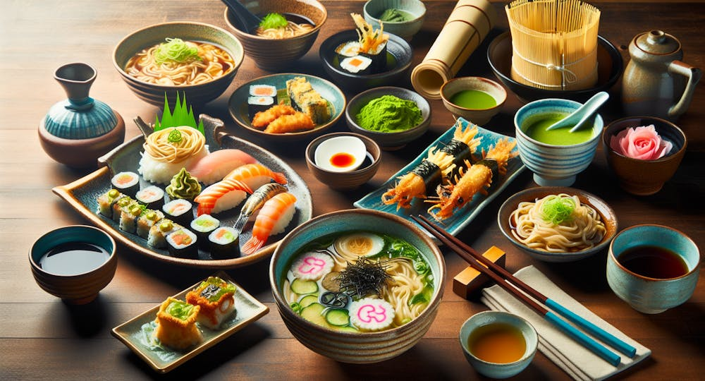
Seasoning
&
Flavoring

Slide 14
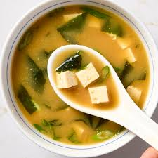
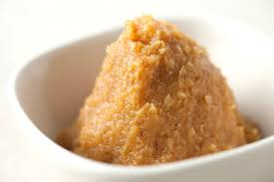
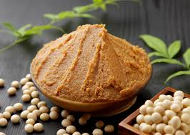
Miso (Soy Bean)
a traditional Japanese seasoning. It is a thick paste produced by fermenting soybeans with salt and kōji

Slide 15
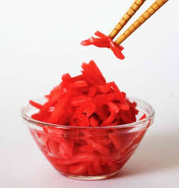
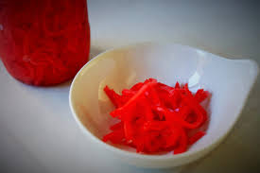
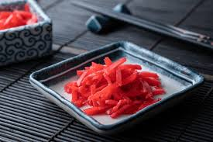
Beni Shōga
a type of tsukemono (Japanese pickle). It is made from thin strips of ginger pickled in umezu

Slide 16
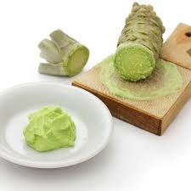
Wasabi
grown for its rhizomes, which are ground into a paste as a pungent condiment for sushi and other foods

Slide 17
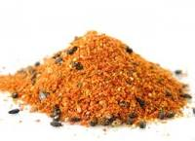
Shichi-mi tōgarashi
Shichimi is a common Japanese spice mixture containing seven ingredients. Tōgarashi is the Japanese name for Capsicum annuum peppers.

Slide 18
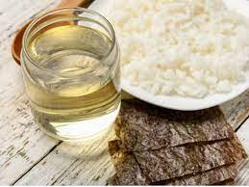
Su (Rice Vinegar)
Golden in color, with as sweet fragrance, its flavor is less harsh than white wine vinegar.

Slide 19
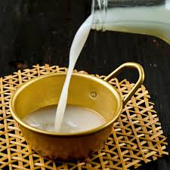
Mirin (Rice Wine)
Meant for cooking. Involves some of the same techniques in brewing as sake, its taste and consistency differ drastically.

Slide 20
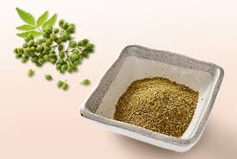
Sansho
Ground pod of prickly ash after it let out the seeds. It is pungent and often sprinkled on a grilled eel.

Slide 21
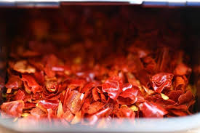
Wagiri - Tougarashi
Dried hot red chili peppers. Often used for stir fried dish such as kimpira burdock.

Slide 22
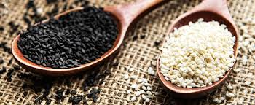
Goma
Are black and white sesame seeds. Use for topping. The flavor enhances when roasted and ground.

Slide 23
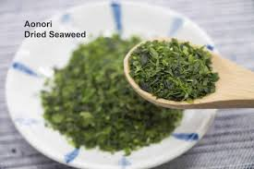
Aonori
Dried powder of green laver. Woth its distinctive aroma and flavor, used for the topping onokonomiyaki and yakisoba.

Slide 24
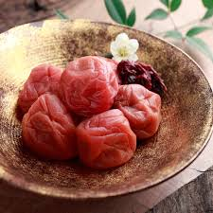
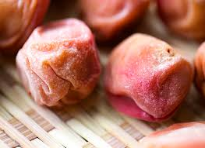
Umeboshi
Pickled plums with strong acid-salty flavor.

Slide 25
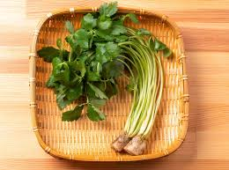
Mitsuba
English name is trefoil. Member of the parsley family. It is used fresh or after lightly parboiled in many dishes.

Slide 26
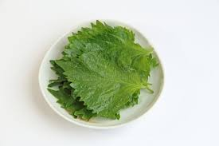
Shiso or Ooba
English name is perilla, member of the mint family. Used as a whole or chopped in a variety of dishes.

Slide 27
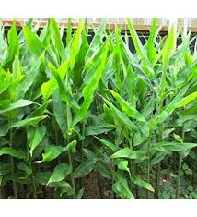
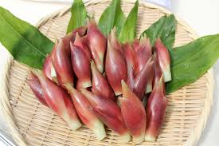
Myouga Ginger
An edible flower buds with refreshing aroma and taste.

Slide 28
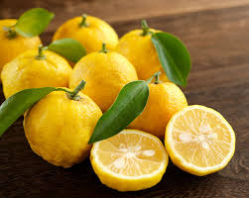
Yuzu Citron
Is like a lemon or lime and is a season trough winter.

Slide 29
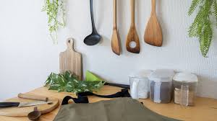
Tools and Equipments

Slide 30
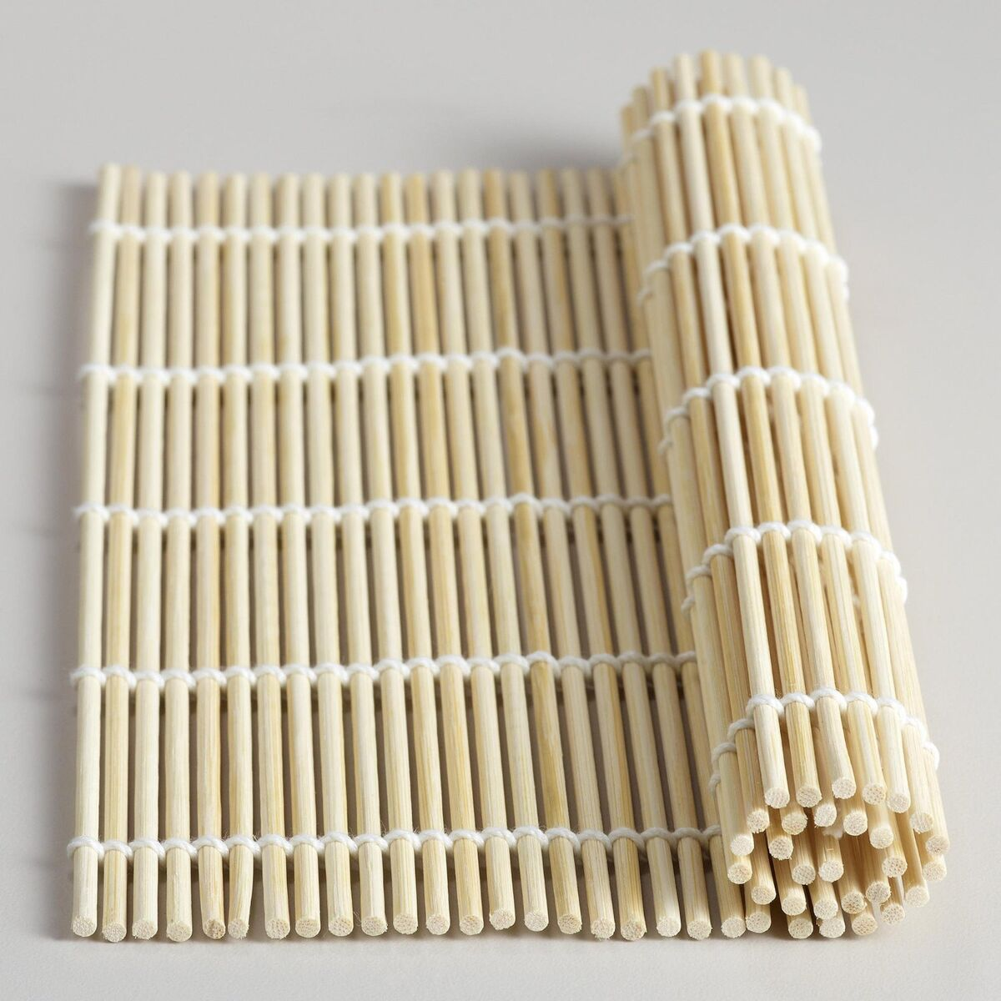
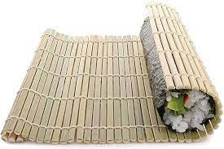
Bamboo Mat
his type of bamboo sushi mats are typically used to roll 'makizushi', a type of rolled sushi that consists of nori (seaweed), vinegared rice and a selected fish or vegetable. Typically, a sheet of nori (seaweed) is placed on top of the mat.

Slide 31
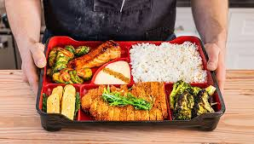
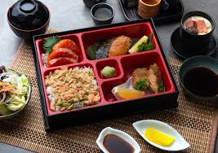
Bento Box
A bento box is a Japanese single-portion boxed meal consisting of several different food types. Bento boxes have multiple compartments, allowing the preparer to separate the various foods into neat and aesthetically-pleasing portions.

Slide 32
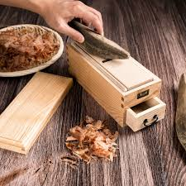
Bonito Shaver
is a traditional Japanese kitchen utensil, similar to a wood plane or mandoline. It is used to shave katsuobushi, dried blocks of skipjack tuna (katsuo).

Slide 33
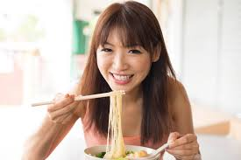
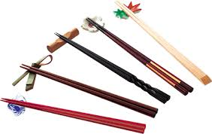
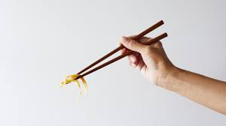
Chopsticks
Chopsticks are shaped pairs of equal-length sticks that have been used as kitchen and eating utensils in most of East Asia for over three millennia.

Slide 34
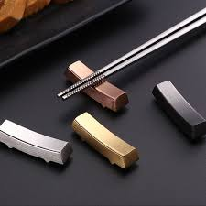
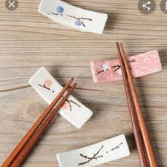
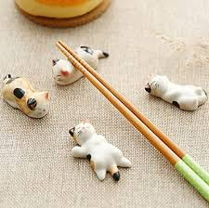
Chopstick Holder
Chopsticks have always been accompanied by an unassuming, but very essential tool: the hashi-oki chopstick rest, which is sometimes also referred to as a hashi-makura, or chopstick pillow

Slide 35
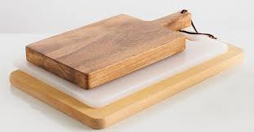
Cutting Board
A cutting board (or chopping board) is a durable board on which to place material for cutting.

Slide 36
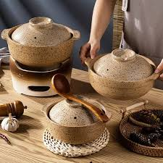
Earthenware Casserole
An earthenware casserole is a pot made from baked clay that can be used for cooking, roasting, and storing food

Slide 37
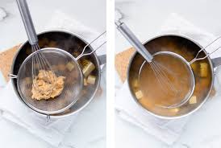
Miso Strainer
The miso strainer is traditionally used for making miso soup. This set includes a strainer and pestle, allowing you to push the paste through the mesh while straining out particles for a clear soup. The miso strainer features a sturdy wooden handle and a hook to hang it on pots or bowls

Slide 38
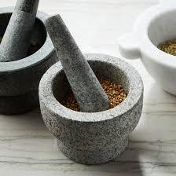
Mortar and Pestle
A mortar and pestle is a set of tools used to grind and crush ingredients into a powder or paste. It's used in kitchens, laboratories, and pharmacies.

Slide 39
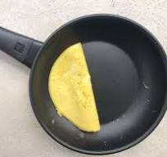
Omelette Pan
Although you can still cook eggs in a fry pan, having an omelette pan will help take your eggs to the next level. Having rounded edges make it easier to roll, flip, and plate your omelette, allowing you to achieve the most delicious omelettes that you'll crave all day long.

Slide 40

Rice Cooker
A rice cooker is a piece of kitchen equipment that cooks many varieties of rice and grains. They work by boiling water, which is then absorbed into the rice until it becomes tender.

Slide 41

Rice Paddle
A rice paddle is a large flat spoon used in East Asian cuisine. It is used to stir and to serve rice, to dip gochujang, and to mix vinegar into the rice

Slide 42


Skewers
Skewers are long, thin pins made of metal or wood that hold pieces of food together, typically for cooking. They are often used for grilling, roasting, or broiling meat and vegetables. The term "skewer" can also refer to the food item itself that's served on the skewer, such as "chicken skewers"

Slide 43


Wasabi Grater
are traditional graters used for grating fresh wasabi, ginger, Japanese yam, and horseradish roots. Typically made with shark skin, it's sandpaper like texture is the perfect abrasive for grating wasabi into an ultrafine paste.

Slide 44


Wooden Drop Lid
are Japanese-style drop-lids for use in Japanese cooking. These round lids float on top of the liquid in a pot while simmering foods. They ensure that the heat is evenly distributed and reduce the tendency of liquid to boil with large bubbles.

Slide 45
Famous Dishes

Slide 46

Sushi

Slide 47

Tempura

Slide 48

Japanese Curry Rice

Slide 49

Takoyaki

Slide 50


Yakitori

Slide 51

Yakiniku

Slide 52

Rice/Gohan

Slide 53

Sashimi & Sushi

Slide 54

Sukiyaki

Slide 55

Okonomiyaki

Slide 56

Ramen

Slide 57




Mochi

Slide 58

Onigiri

Slide 59

Bento

